Slide 1
Logical Database Design Mapping ER Models to Relational Models
Also called “transformation” of conceptual models to logical models.
Entity-relationship model -> relational model
Acknowledgement: Dr. S. Hong provided some of the material for this set of lecture notes.

Slide 2
Objectives
Understand how to transform an ER model into a relational model
Constructs of an entity-relationship model
Entity types
attributes (key, non-key)
Relationship types
1:N
M:N
1:1
Construct of relational model
Relation

Slide 3
Data modeling is part of database design methodology
Requirements
Collection & Analysis
Requirement collection methods
Requirement specifications
Data Modeling
Conceptual
Design
Data modeling methods, e.g. E-R modeling, crow’s feet
Conceptual database models
Logical
Design
Database Systems (Relational Databases)
Logical models &
Performance requests
Physical
Design
DBMS (Oracle, SQLServer, …)
Database Schema
Application
Design
Application dev. methods
Database Applications

Slide 4
The Relational Model (Revisited)
Collection of tables, called relations, stored in a database
Simplicity
Key concepts:
A table (relation) refers to a list of data arranged in columns (fields) and rows (records)
Structured to minimize redundancy
A database is either a single table or a collection of related tables
A column (field) defines the data that a table can hold
A row (record) represents a single instance of whatever the table keeps track of
A key is the field(s) used to uniquely identify each record in a table and to relate tables in a database
SQL (Structured Query Language) – for creating and querying a database

Slide 5
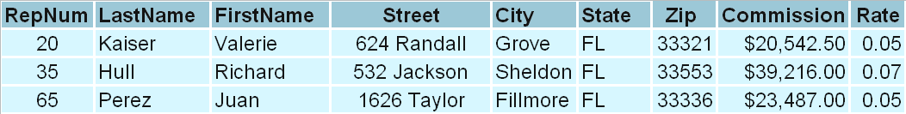
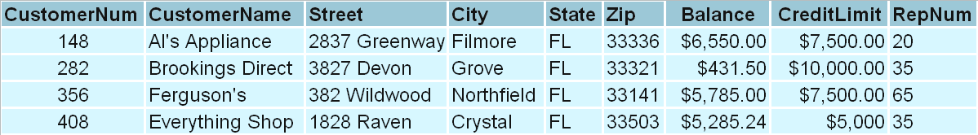
Simple Database (Revisited) Customers of sales representatives
Sales Representative (i.e. Employee)
Customer
What queries might you ask of this database? Note: minimize redundancy.
Notes:
This is a relational database. Information about various topics are stored in tables. You can add more tables (or topics) quite easily and link them together to ask questions such as:
Which salesperson has the most profitable customers?
What region has the most sales leads?
Add tables to track orders, inventory, etc.
Ref. C. Anderson

Slide 6
Logical design: Transform conceptual model into a logical model to be implemented in a relational database
Relational model has one construct (relation/table)
Conceptual ER models are very descriptive (semantics rich)
ER modeling concepts must be converted to relational concepts
Entities -> relations
Relationships -> foreign key in existing relation; or new relation
Depends on min/max cardinalities
Conceptual ER Model | Relational Model
Entity types | Relation (table)
Single valued attributes | Single-valued attributes
Relationships (1-to-1, 1-to-N) | Foreign keys
Many-to-many (N:M) relationships (w/ relationship attributes possible) | Relation (table)

Slide 7
Translation to Logical Model
Transformation / Conversion / Mapping Rules – Entity [Note: Do not confuse mapping rules with mapping ratios]
Each entity becomes a relation (table) with same key
Transformation / Conversion / Mapping Rules -- Relationship
1:N – Foreign key
(0,1) and (0/1,N) – foreign key (can have null value)
(1,1) and (0/1,N) – foreign key (cannot have null value)
N:M – New relation
(0/1,N) and (0/1,M)
Key is concatenation (joining together) of keys of the two entities
Relationship attributes become non-keys
1:1 – foreign key
(1,1) and (1,1) – foreign key in either relation (decide based upon usage)
(0,1) and (1,1) [or (1,1) and (0,1)] – use foreign key such that there are no null values allowed.

Slide 8
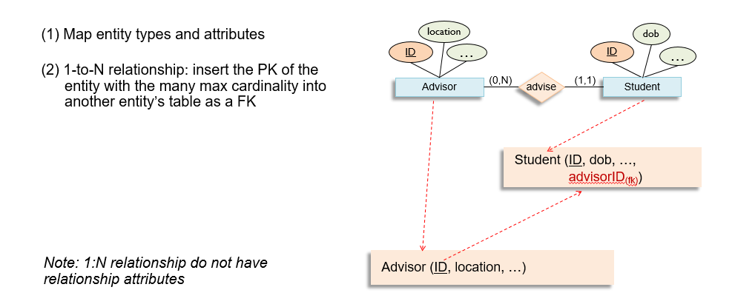

Binary (1-to-N) relationship represented as foreign keys
Note: 1:N relationship does not have relationship attributes

Slide 9
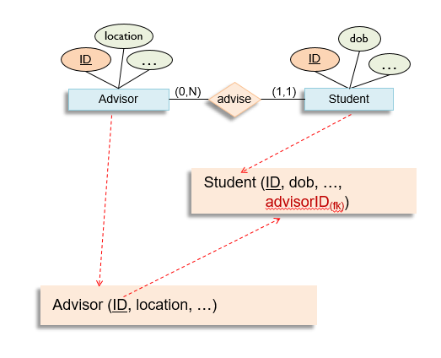
Binary (1-to-N) relationship represented by foreign keys
Relations:
Advisor: [AdvisorID, location, …]
Student: [StudentID, dob, …. advisorID]

Slide 10
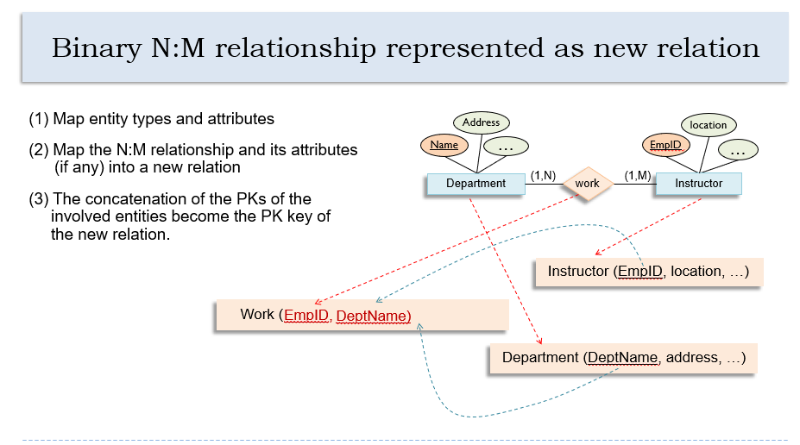

Slide 11
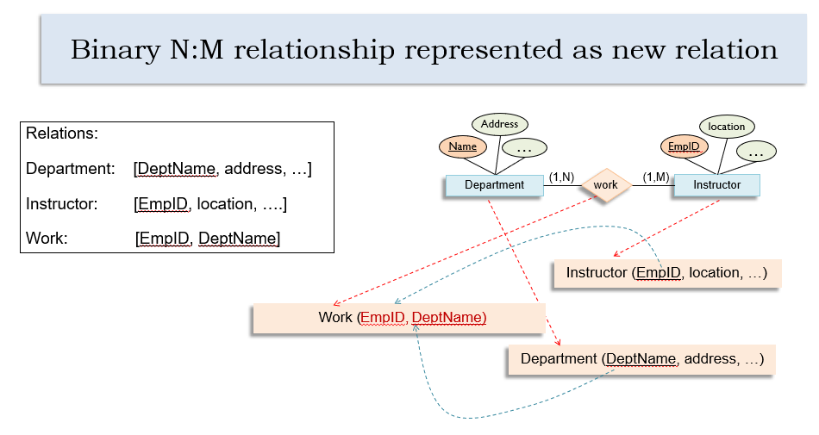

Slide 12
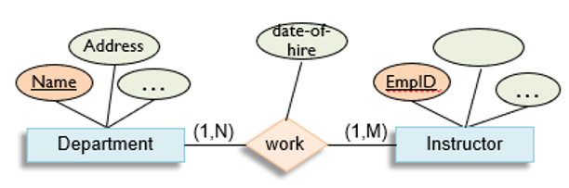

Binary N:M relationship with relationship attributes

Slide 13
Binary N:M relationship with relationship attributes
Address
date-of-hire
location
Relations:
Department: [Name, address, …]
Instructor: [EmpID, location, ….]
Work: [EmpID, DeptName, date-of-hire]
Name
…
EmpID
…
Department
(1,N)
work
(1,M)
Instructor

Slide 14
1:1 Relationship
Every dept must have one (and only one)
department head.
Options:
-- foreign key in either relation
Department: [DeptName, location, … EmpID]
Or:
Dept-Head: [EmpID, name, …., DeptName]
How would you decide?
location
name
Name
…
EmpID
…
Department
(1,1)
has
(1,1)
Dept-Head

Slide 15
Optional 1:1 Relationship
Business rule: department
can have at most one
department head
Head: [EmpID, name, …., DeptName]
Where “DeptName” is not allowed to have a null value.
location
name
Name
…
EmpID
…
Department
(0,1)
has
(1,1)
Head

Slide 16
Optional 1:1 Relationship in both directions
What if both optional?
Dept-Head: [EmpID, DeptName]
-or- Head: [EmpID, name, …., DeptName]
(null FK allowed)
-or- Dept: [DeptName, … EmpID]
(null FK allowed)
location
name
Name
…
EmpID
…
Department
(0,1)
has
(0,1)
Head

Slide 17
Ternary relationships mapped to separate relation
Student_Id
(1) Map entity types and attributes
STUDENT
(2) Map the ternary relationship and its attributes (if any) into a new relation
Course_Id
(0,N)
term
Instructor_Id
grade
COURSE
(0, N)
class
(0, N)
INSTRUCTOR
Class: [Student_Id, Course_Id, Instructor_Id, term, grade]
Assumptions inherent in this example?

Slide 18
Summary
Mapping rules
Conceptual data model → relational data model
Most common
1:1, 1:N, M:N
Others – unary, ternary
Special cases, exceptions
Understand application being modelled
More examples coming

